Slide 1

MEDICAL PRESCRIPTION WRITING ROBOT
C16
DOMAIN-EMBEDDED
SUBITHA VARSHINI.V -211417104271
VENNILA.D - 211417104297
HARITHA.V - 211417104319
GUIDE : Mrs.P.Deepa
Associate Prof, Dept of CSE
Panimalar Engineering College

Slide 2
ABSTRACT
The approach is to design rapid and fluid movements of a universal robot to perform robot writing mimicking the doctor prescription writing when signing and the trajectory.
Reading a doctor’s handwritten prescription is a challenge that most patients and some pharmacists face; an issue that, in some cases, this lead to negative consequences due to wrong deciphering of the prescription. Part of the reason why doctor's prescriptions are so difficult to decipher is that doctors make use of Latin abbreviations and medical terminology that most people don't understand.
To perform the task, on-line human signing standards are created first. Robot writing task is performed using these standards after that and robot signatures are acquired as a result. Finally, recommendations of robot motion improvement are given.

Slide 3
LITERATURE SURVEY
TITLE OF THE PAPER | AUTHOR NAME | METHODOLOGY | DISADVANTAGES
Digitalization of Medical Prescription International Research Journal of Engineering and Technology(IRJET) mar 2018 | Ananthu T .S1 Athira Jayan2 Felna Francy Chazhoor3 Linnet Tomy4 | Personal Digital Assistant(PDA) | At the beginning itself the product cannot give its full productivity
Development Of Smart Medical Prescription Service Model Conference paper sep 2018 | Bijoya Lalaa Sabikun Naherb Mohammed Arif I Mahmoodc Md. Murshadul Hoqued | Website structure and Database management scenario Configuration of phpMyAdmin and website build process SMPS development flowchart | The diagnostic center can view only physical examination test section of prescription written by the doctor

Slide 4
TITLE OF THE PAPER | AUTHOR NAME | METHODOLOGY | DISADVANTAGES
An Electronic Prescription System powered by Speech Recognition, Natural Language Processing and Blockchain Technology International Journal Of Scientific & Technology Research August 2019 | Jitendra Mahatpure Dr Mahesh Motwani Dr Piyush Kumar Shukla | Hyperledger Composer Blockchain Network Node.js REST APIs Python Django REST APIs React-Native Mobile Application React JS Web Application | The system in the real hospital ecosystem to test and validate the implementation and to analyze the impact it will create in the healthcare domain is worse
Web Controlled Surveillance Robot International Journal of Emerging Technology and Advanced Engineering October 2015 | Devjyoti Ghosh1 Shaarang Sahanie2 Shreyas Bhandari3 Vedant Shirali4 Mudit Kapoor5 | Android Implementation Chassis Implementation Network Implementation | An android map with a microcontroller that will enable us to use the GPS and send the robot to a specific location by choosing the path from the map

Slide 5
TECHNOLOGY STACK HARDWARE REQUIREMENTS SOFTWARE REQUIREMENTS
ATMega328 MICRO CONTROLLER
Bluetooth Module
Liquid Crystal Display
Stepper Motor Driver
Stepper Motors and Servo Motor
Gear and Belt Setups
Adapter
5*1 Keypad
Embedded C
Android Application
AVR IDE

Slide 6
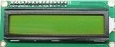
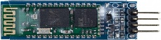
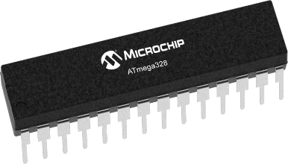
SYSTEM ARCHITECTURE
RECEIVER SECTION
TRANSMITTER
SECTION

Slide 7
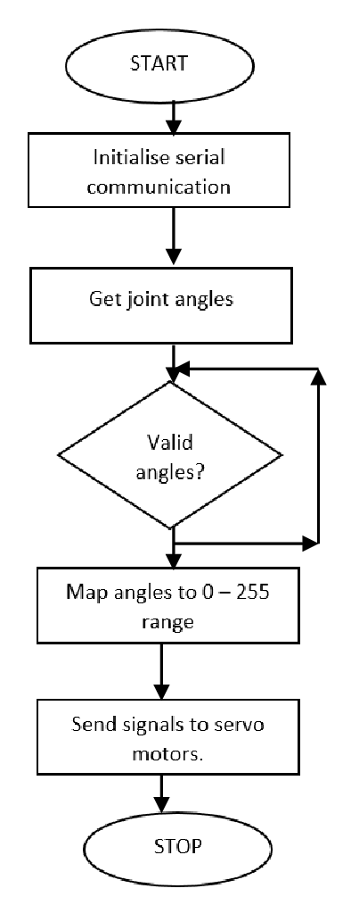
SYSTEM DESIGN
FLOW DIAGRAM

Slide 8
USECASE DIAGRAM
LOGIN
USER
Recognize
User Voice
Transfer via Bluetooth
Bluetooth Module
ROBOT
Writes prescription

Slide 9
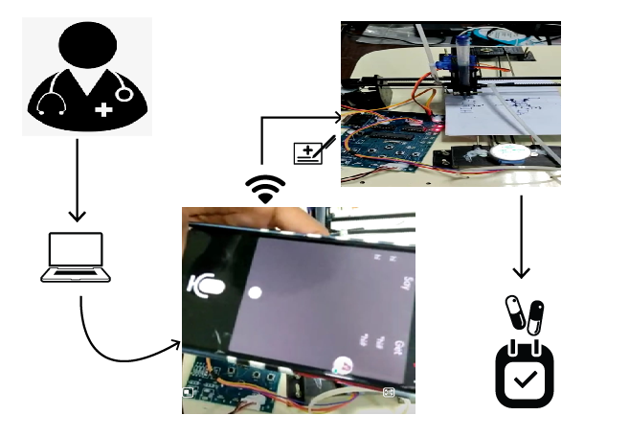
PROCESS FLOW DIAGRAM

Slide 10
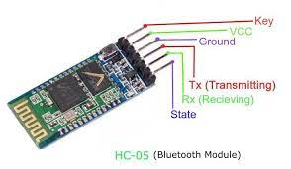
MODULES DESCRIPTION
BLUETOOTH MODULE :
Bluetooth is a telecommunications industry specification that describes how mobile phones, computers, and personal digital assistants (PDAs) can be easily interconnected using a short-range wireless connection.

Slide 11
ATMega328 MICRO CONTROLLER :
The Atmel AVR core combines a rich instruction set with 32 general purpose working registers. All the 32 registers are directly connected to the Arithmetic Logic Unit (ALU), allowing two independent registers to be accessed in a single instruction executed in one clock cycle.
The resulting architecture is more code efficient while achieving throughputs up to ten times faster than conventional CISC microcontrollers.

Slide 12
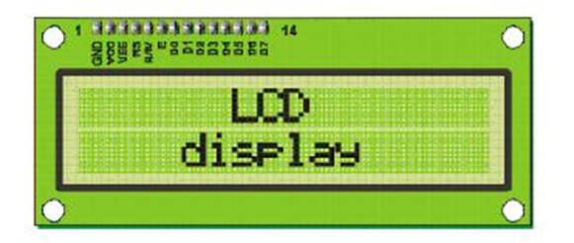
LCD :
LCD stands for Liquid Crystal Display. LCD is finding wide spread use replacing LEDs (seven segment LEDs or other multi segment LEDs)
The components are “specialized” for being used with the microcontrollers, which means that they cannot be activated by standard IC circuits. They are used for writing different messages on a miniature LCD.

Slide 13
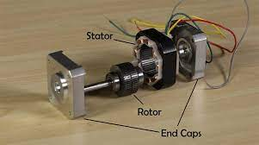
STEPPER MOTOR :
Stepper motor (also called as step motor) is basically a brushless DC motor, whose rotor rotates through a fixed angular step in response to input current pulse. That means, the full rotation of the rotor is divided into equal number of steps, and rotor rotates through one step for each current pulse.

Slide 14
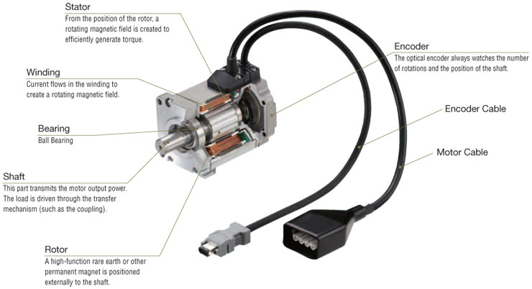
SERVO MOTOR :
A servo motor allows precise control of linear or angular position, speed. And it is a rotary actuator. It involves a sensor which is coupled to a motor for location feedback. It also requires a servo driver to send the feedback about the PWM signals. It refers to a motor appropriate for use in a closed-loop control system.

Slide 15
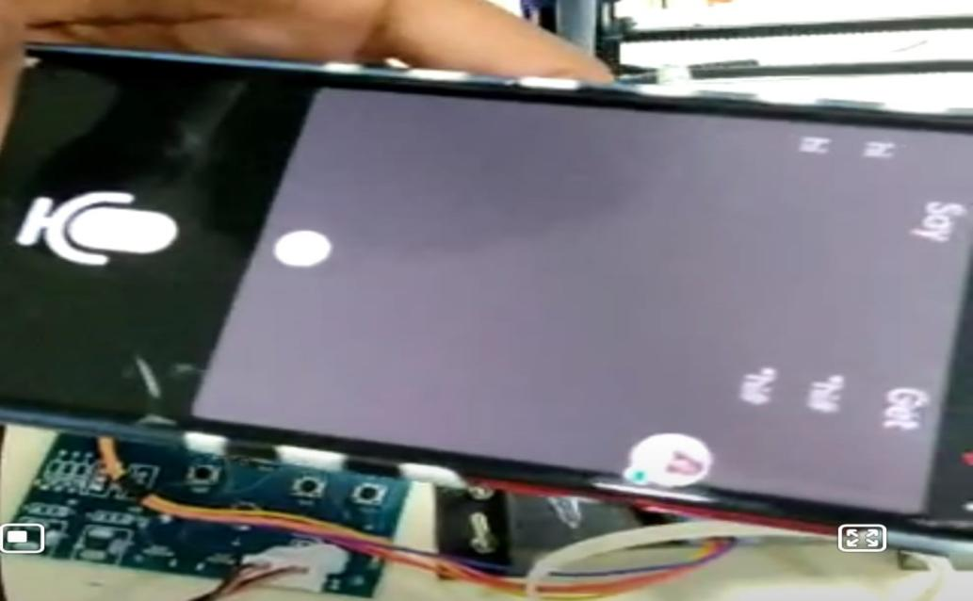
SCREENSHOTS OF WORKDONE
VOICE RECOGNITION

Slide 16
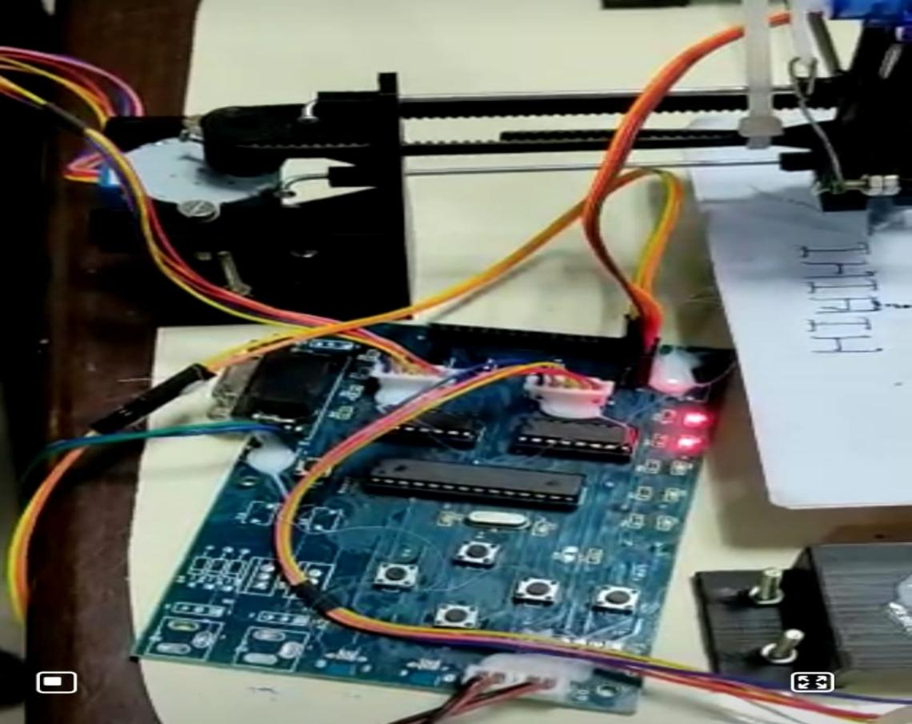
CONTROL SWITCHES

Slide 17
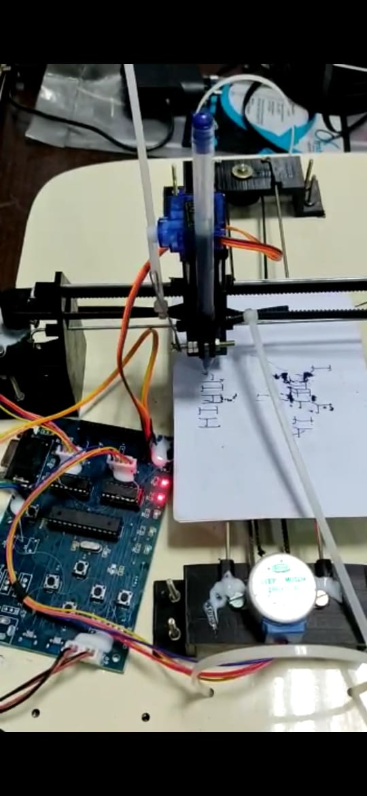
PRESCRIPTION WRITING

Slide 18
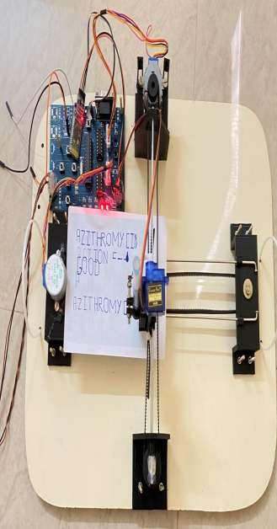
FULL HARDWARE MODULE

Slide 19
ADVANTAGES
Automation is implemented and thus the data collection and analysis is made easier
Accuracy
Optimized character axis
Cost effective approach
Time consumption is saved

Slide 20
FUTURE SCOPE
In our project the writing speed is slow since we use the servo motor. So, In order to increase the speed we can use the DSP (Digital Signal Processing) in future if needed. Even it can be used for handicapped people during their examination. The people who can’t write can use this instead of depending on some other people.

Slide 21
CONCLUSION
In this paper, our approach is to discover a robot that can write a medical prescription what doctor says in mobile app, so that the patients and the pharmacists can understand what is written in the prescription. now the patients can take the correct medicine and the pharmacist can give the right medicine. we present a method to design rapid and fluid movements of a universal robot to perform robot writing mimicking the kinematics and trajectory of human handwritten signatures. The handwriting specimen acquisition, writing specimen processing, robot writing and comparison of on-line human and robot signatures are the phases of the experimental research performed.

Slide 22
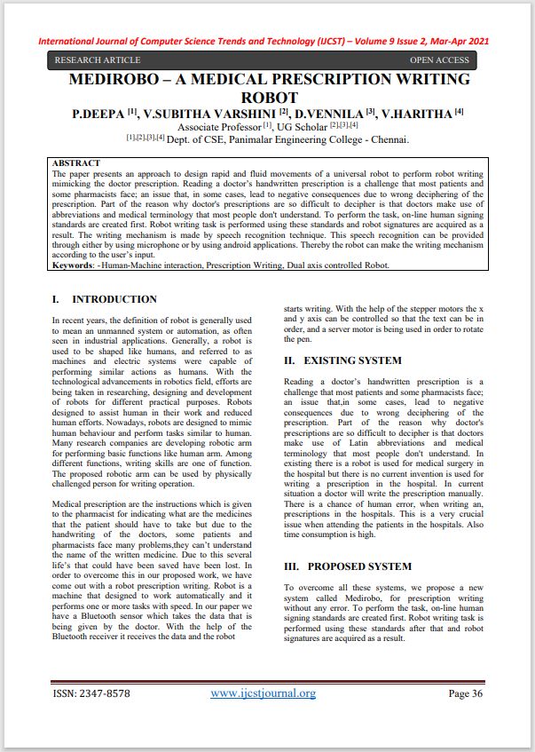
PUBLICATIONS
Journal Name : IJCST
Title : MEDIROBO - A Medical Prescription
Writing Robot
Volume : Volume 9
Issue : Issue Number 2
Year : 2021
Link : http://www.ijcstjournal.org/current-issue.html

Slide 23
REFERENCES
[1] Roger Achkar, Khodor Ghayad, Rayan Haidar, Swasan Saleh, Rana Al Hajj,”Medical Handwritten Prescription Recognition Using CRNN “,IEEE (2019).
[2] Kanstantsi Miatliuk,Adam Wolniakkowski,Moises Diaz,Jose J.Quintana,Miguel A.Ferrer,”Universal Robot Employement to mimic human writing”,IEEE(2019).
[3] B. Moysset, C. Kermorvant, and C. Wolf proposes“Full-page text recognition: Learning where to start and when to stop,”arXiv: 1704, 08628, 2017.
[4] T. Bluche demonstrates“Joint line Segmentation and transcription for end-to- end handwritten paragraph recognition,” in Advances in Neural Information Processing Systems, 2016, pp.
[5] P. Voigtlaender, P. Doetsch, and H. Hey publish about “Handwriting recognition with large multidimensional long short-term memory recurrent neural networks,” in Frontiers in Handwriting Recognition inyear 2016.15th international Conference on. IEEE, 2016.

Slide 24
[6] Youssef Harkouss and Roger Achkar have published a paper “The Accurate wavelet neural network for the efficient controlling of an active magnetic bearing system” 2010.
[7] George Abou Kassm and Roger Achkar demonstrates Apr cnn cascade and adaptive deskewing. Procedia Computer Science, 114:296–303, 2017.
[8] M. Diaz, M. A. Ferrer and J.J. Quintana. "Robotic Arm Motion for Verifying Signatures". 16th International Conference on Frontiers in ICFHR,, USA, 5-8 August 2018.
[9] C. Valsamos, A. Wolniakowski, K. Miatliuk, V.C. Moulianitis proposed the Minimization of joint velocities during the execution of a robotic task byarticulated manipulator, Advances in Service and Industrial Robotics, Mechanisms and Machine Science, Springer, vol. 67, 2018, pp. 368-375.
[10] Dr. Nomal Chandra Borah, Chairman & Managing Director published there paper in Guwahati Neurological Research Centre. Doctor’s illegiblehandwriting creating confusion leads to deathon April 20, 2015

Slide 25


